Slide 1
Graphical Models
Combination of probability theory and graph theory.
Graphical models can deal with uncertainty and complexity
Notion of modularity – a complex system is built by combining simpler parts.
Probabilistic graphical models are graphs in which nodes represent random variables, and the (lack of) arcs represent conditional independence assumptions. Hence they provide a compact representation of joint probability distributions.
There are two main kinds of graphical models: undirected and directed.
Undirected graphical models (eg: Markov models) are more popular with the physics and vision communities.
Directed graphical models (Bayesian belief networks) are more popular with the AI and machine learning communities

Slide 2
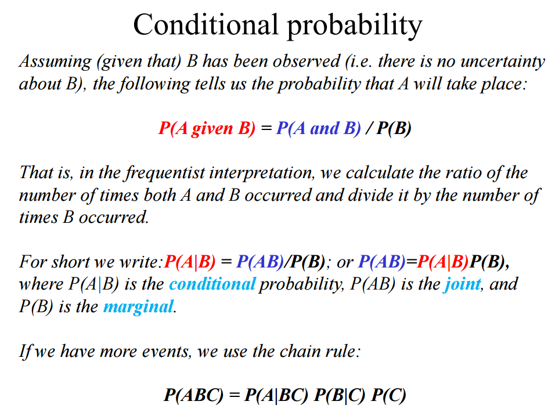

Slide 3
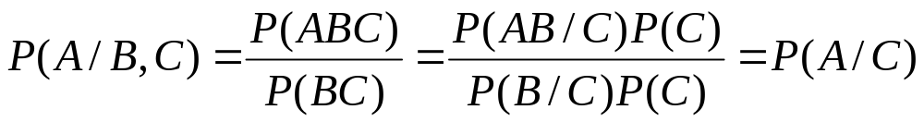
Absolute independence:
  A and B are independent if P(A ∧ B) = P(A) * P(B); equivalently, P(A) = P(A | B) and P(B) = P(B | A)
A and B are conditionally independent given C if
  P(A ∧ B | C) = P(A | C) * P(B | C)
This lets us decompose the joint distribution:
  P(A ∧ B ∧ C) = P(A | C) * P(B | C) * P(C)

Slide 4
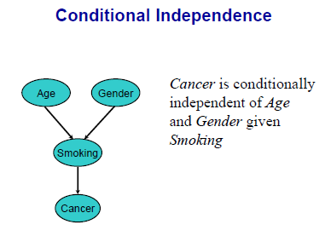

Slide 5

Bayesian Belief Networks (BNs)
Definition: BN = (DAG, CPD)
  DAG: directed acyclic graph (BN’s structure)
    Nodes: random variables (typically binary or discrete, but methods also exist to handle continuous variables)
    Arcs: indicate probabilistic dependencies between nodes (lack of link signifies conditional independence)
  CPD: conditional probability distribution (BN’s parameters)
    Conditional probabilities at each node, usually stored as a table (conditional probability table, or CPT)
  Root nodes are a special case – no parents, so just use priors in CPD:

Slide 6
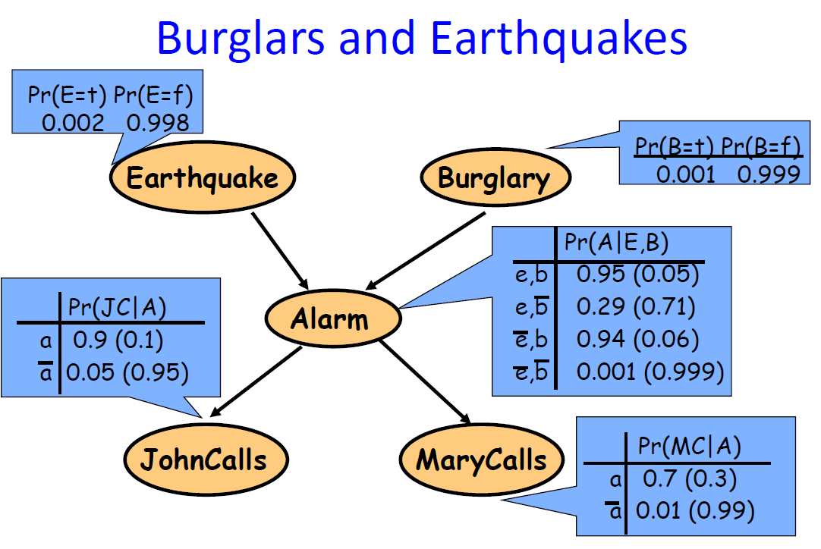

Slide 7
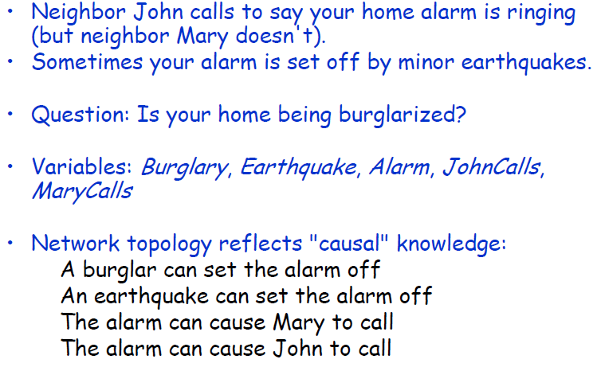
Suppose you are away..

Slide 8
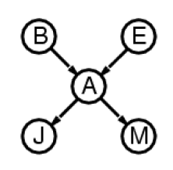



Slide 9
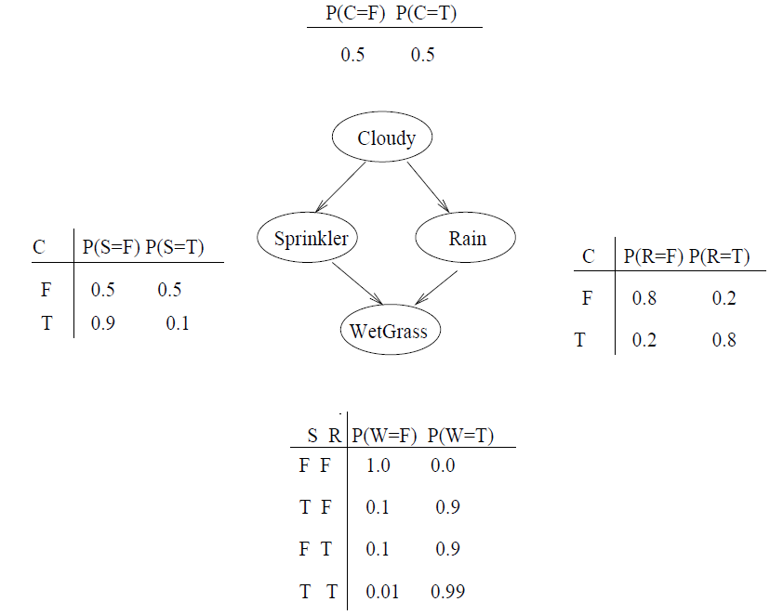



A Bayesian Belief Network
Chain rule
Conditional Independence

Slide 10
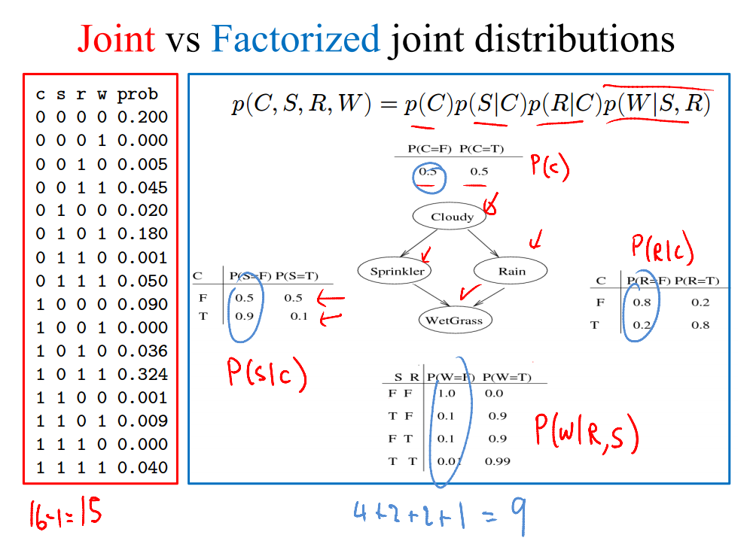

Slide 11
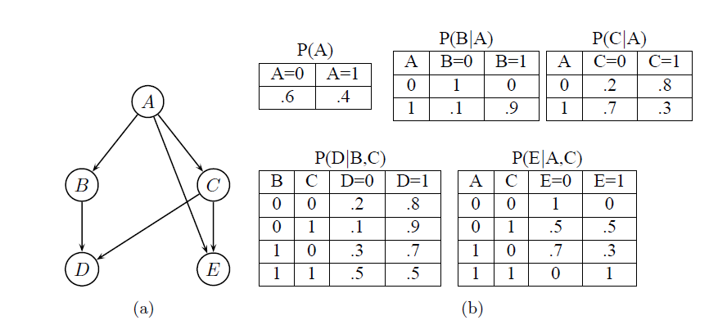


A Bayesian network and its CPTs

Slide 12
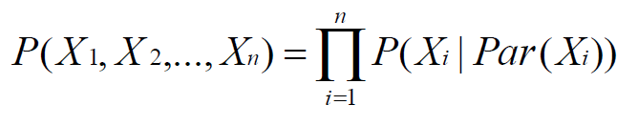

Bayesian network represents the following joint probability distribution
This is from the graph structure
P(A = 0,B = 0,C = 0,D = 1,E = 0) =P(A)*P(B/A)*P(C/A)*P(D/B,C)*P(E/A,C)
= 0.6×1×0.2×0.8×1=0.096
These numbers are from the conditional probability tables

Slide 13
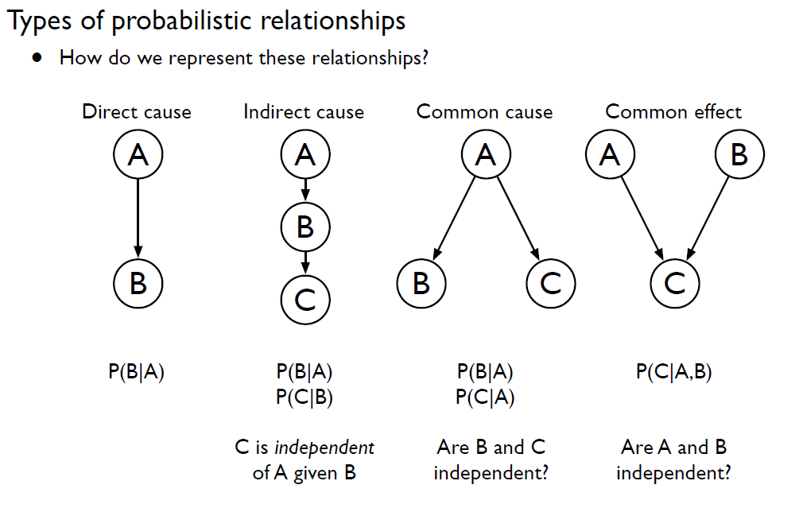

Slide 14
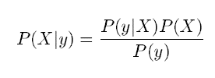
Inference
The main goal of inference to estimate the values of hidden nodes, given the values of observed nodes.
If the grass is wet, what are the causes?
Either it is raining or sprinkler is on. Which is more likely?
X hidden nodes (random variable)
Y observed evidence (sampled value)
Using a Bayesian network to compute probabilities is called inference
In general, inference involves queries of the form: P( X | E )
E = The evidence variable(s)
X = The query variable(s)

Slide 15
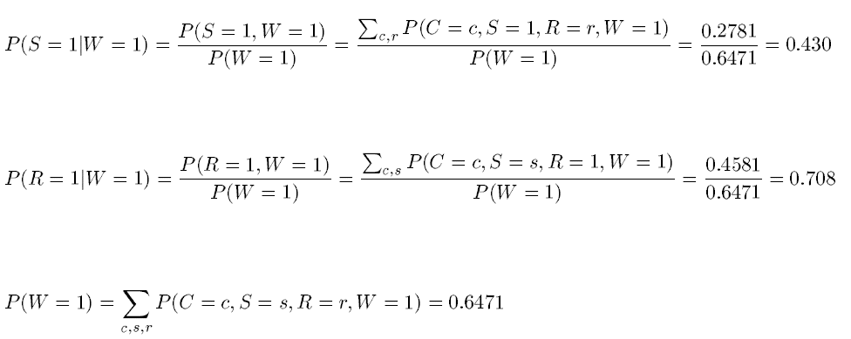
For the network in slide 9

